Slide 1
Task : Retrieval of text spans from relevant articles for biomedical question answering
Team : SUV
Team Members : Suyash Namdeo(17CE10059)
Vivek Pal (17MA20048)
Vinay Kumar Agarwal (17MA20051)
Utkarsh Pratap (17MT10043)

Slide 2
Problem Statement / Task Overview
Given a question and a set of relevant articles independent of the question, we are supposed to extract the relevant article along with the word span of the text relevant for answering that particular question. In this task, we have to explore answering the factoid /yes-no/ list questions. The corpus used is the BioASQ shared task-7b phase b corpus. We were supposed to explore various state-of-the-art deep learning QA techniques to solve the problem.

Slide 3
Model Architecture
Seq2seq.py : One-hot encoding input that is paragraph_context + ' Q ' + question
Seq2seq_v2.py : One-hot encoding input that is add(paragraph_context, RepeatVector(LSTM(question)))
Seq2seq_glove.py : GloVe encoding input that is paragraph_context + ' Q ' + question
Seq2seq_v2_glove.py : GloVe encoding input that is add(paragraph_context, RepeatVector(LSTM(question)))

Slide 4
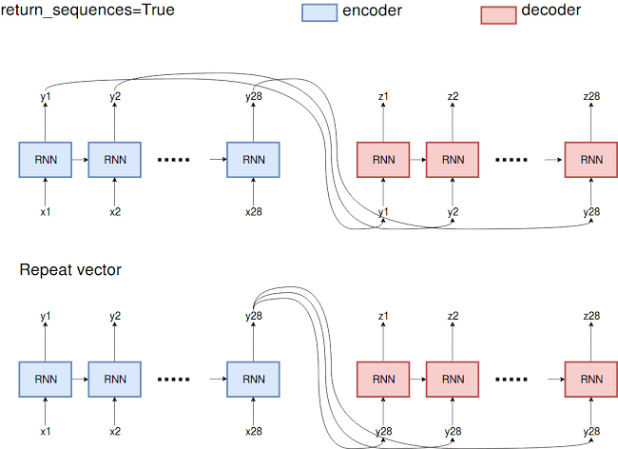
Seq2seq vs Seq2seq with Repeat Vector

Slide 5
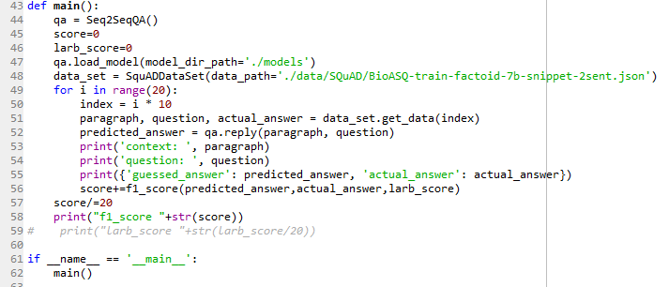

Slide 6
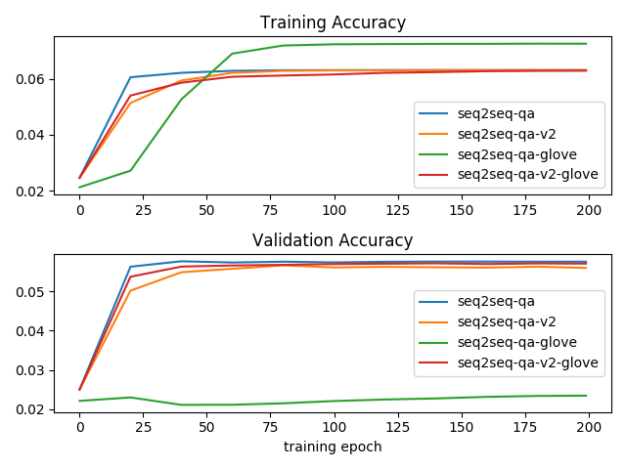

Slide 7
Evaluation
F1 Score is the weighted average of Precision and Recall. Therefore, this score takes both false positives and false negatives into account. In our case, F1 score is 0.81666667 which outperforms the widely used baseline obtained with Infersent embeddings.
Precision = TP/TP+FP
Recall = TP/TP+FN
F1 Score = 2*(Recall * Precision) / (Recall + Precision)

Slide 8
Result
Model | F1-Score
seq2seq-qa | 0.7999999
seq2seq-v2-qa | 0.8166667
seq2seq-glove-qa | 0.7499999
seq2seq-glove-v2-qa | 0.7999999

Slide 9
Baseline
Unsupervised Learning Model : Used euclidean distance to detect the sentence having minimum distance from the question. The accuracy of this model came around 45%. Then, I switched to cosine similarity and the accuracy improved from 45% to 63%.
Supervised Learning Model : Paragraph length to 10 sentences for simplicity. The idea is to match the root of the question which is which may be same for a sentence in any case to all the roots/sub-roots of the sentence.The random forest gave an accuracy of 67% .
Seq2seq model achieves F1 score of 0.816667

Slide 10
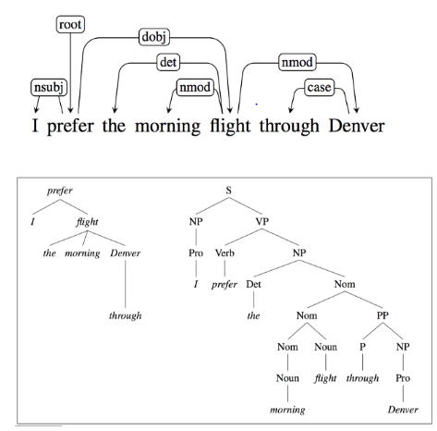
Dependency Parsing Example for Baseline

Slide 11
Conclusion
Seq2seq performs better than baseline model. We have trained the model for BioASq 7b/train/Full_Abstract/BioASq-Factoid dataset as well as for list-7b dataset with 200 epochs and batch size of 64. From error analysis it is evident that among different variants of seq2seq model, the one which is trained with Repeat-Vector provided the most promising results having the F1-score of 0.8166667 as it is used as an adapter to fit the fixed-sized output of the encoder to the differing length and input expected by the decoder.

Slide 12
Thank You

